Slide 1
Business Development Department
Pre-Budget & Strategy Session FYE 2020
22.02.2019

Slide 2





Agenda
FY 2019 – Year in Review
Competitor Analysis
Sales Performance
FYE 2020 Goals and Targets
Sales Budget
New Products
Incentive Program
Marketing Campaigns
Undesirable Portfolio

Slide 3

FY 2019 – As updated previously
Grade C+ and above
Fin amt > RM10k
Age 20-45
27.04.2018 – 31.08.2018
Maydan gift set
1. HALO and PRESS products
High payout – low comm
Pre-salary adjustment
1.05.2018
2. MR signboards installation
6.06.2018
MR Training – A Culture of Corporate Ethics
18.06.2018
BUNDLE products
Refinancing products for eligible 4.99% and 5.99% customers
1.08.2018 – 31.12.2018
Membership Fee waiver for new YYP customers
RM200k MAST
RM25k Security Deposit
9 MRs
1.09.2018 – 31.03.2019
Opening of Sabah Code
1.09.2018 – 30.11.2018
YYP WAH! Campaign
Min RM18k fin amt
Stand a chance to win a trip for 2 to Bandung
40 TnG cards as consolation
FY 2019 Mid-year Budget

Slide 4
FY 2019 – New updates
Grade C+ and above
Fin amt > RM10k
Age 20-45
10.10.2018
Misrepresentation Penalty Letter
11.10.2018
Corporate Governance Training
1.11.2018
Loanstreet Collaboration
1. YIR WAH! Campaign
Min RM18k fin amt
Stand a chance to win a trip for 2 to Bangkok
120 TnG cards as consolation
1.11.2018 – 31.01.2019
2. Monthly Average Sales Surge Campaign
RM10k voucher = MASS ≥ RM300k
RM20k voucher = MASS ≥ RM500k
28.01.2019
Islamic Financing and SST Briefing
1. H2O Campaign
First-come, first-served
50 Okamizu water filters (fin amt ≥ RM28k)
300 Petronas gift card (fin amt ≥ RM18k)
RM200k MAST
RM25k Security Deposit
9 MRs
2. Reopening to KEMAS contract customers
1.02.2019
3. Letter of Offer template for MRs
Min RM18k fin amt
Stand a chance to win a trip for 2 to Bandung
120 TnG cards as consolation
4. Revised signatory for Sarawak education sector
5. Revised maximum eligible deduction for
Sarawak State sector

Slide 5
FY 2019 – New updates
10.10.2018
Misrepresentation Penalty Letter (“MPL”)
RM100 penalty is imposed for each cancelled application due to misrepresentation effective 1.11.2018
Issuance of first MPL on 15.12.2018
NoA cancelled due to misrepresentation
NoA
Significant reduction of cancelled applications due to misrepresentation
Avg = 17 NoA
Avg = 7 NoA

Slide 6

FY 2019 – New updates
11.10.2018
Corporate Governance Training
Highlights of Companies Act 2016 (“CA2016”) & Their Implications
Attended by 17 MRs
2 MRs absent with apologies due to pre-planned arrangements
Pending Outline

Slide 7
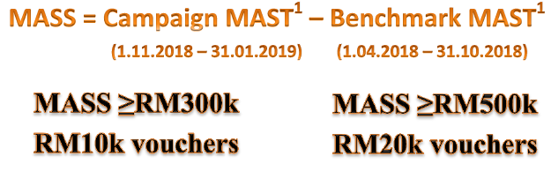
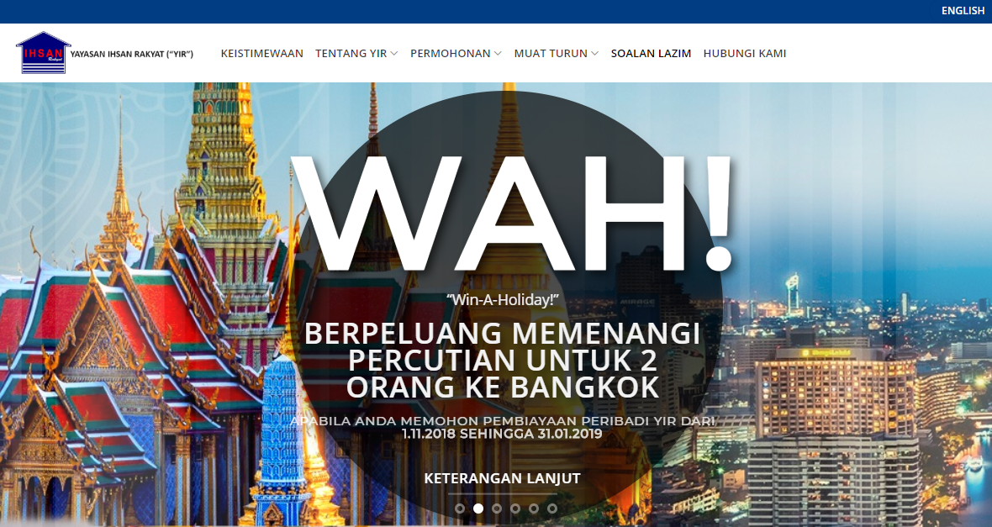
FY 2019 – New updates
1.11.2018 – 31.01.2019
Monthly Average Sales Surge (“MASS”) Campaign
1.11.2018 – 31.01.2019
YIR WAH! Campaign
Min RM18k fin amt
Stand a chance to win a trip for 2 to Bangkok
120 TnG cards as consolation

Slide 8
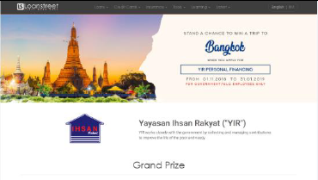
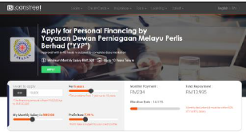
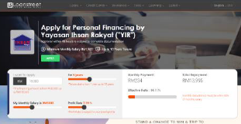
FY 2019 – New updates
Loanstreet Collaboration
1.11.2018
WAH! Promo page
Include BP website stats
Average views per month = 3,511
YYP product page
Average views per month = 3,398
YIR product page
Average views per month = 3,555

Slide 9

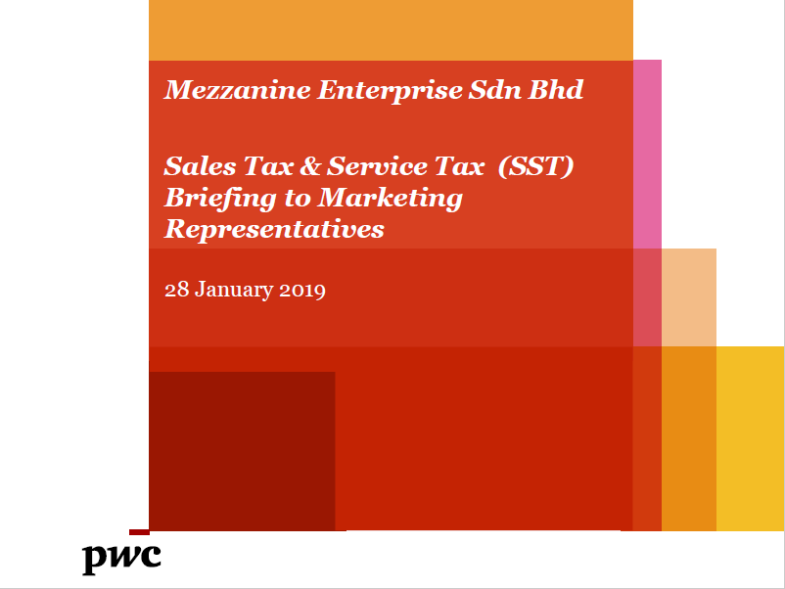
FY 2019 – New updates
28.01.2019
Islamic Financing and SST Briefings
Attended by 21 MRs
Pending Outline

Slide 10
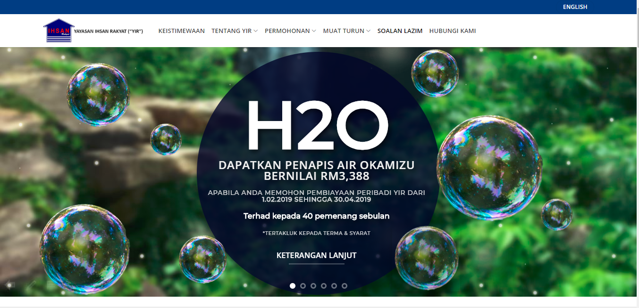
FY 2019 – New updates
1.02.2019 – 30.04.2019
Health-to-Okamizu (“H2O”) Campaign
First-come, first-served basis
Monthly Prizes | YIR | YYP | Total
Okamizu water filter Fin amt ≥ RM28k | 40 | 10 | 50
Petronas gift card Fin amt ≥ RM18k | 240 | 60 | 300

Slide 11

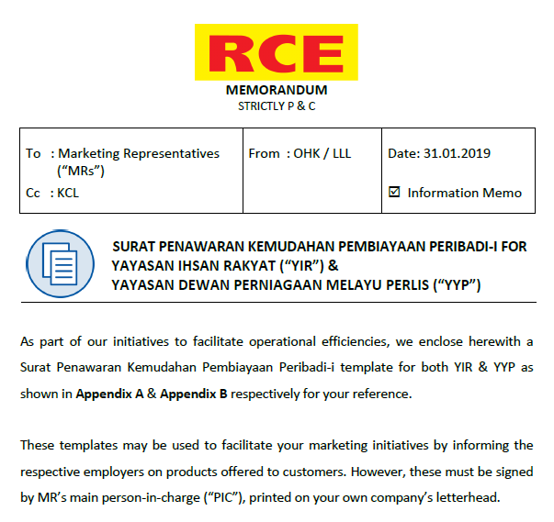
FY 2019 – New updates
1.02.2019 – 31.03.2019
Reopening to KEMAS contract staff
Subject to the following criteria:
2 years minimum service period
All certification signed by Timbalan Pengarah or higher
1.02.2019
Letter of Offer template for MRs
Objective to reaffirm employers of customers and project a professional image as a financial service provider

Slide 12
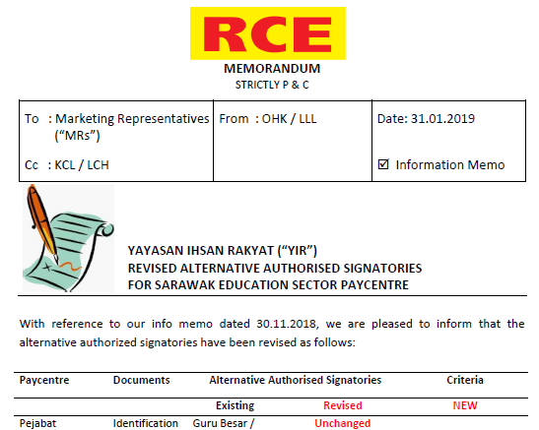
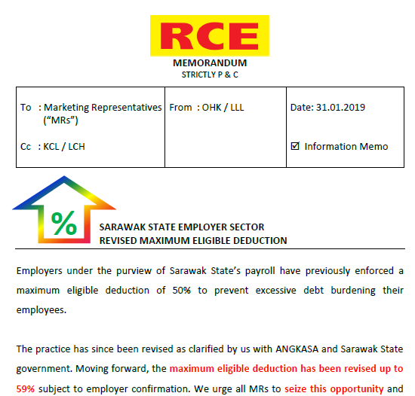
FY 2019 – New updates
1.02.2019
Revised alternative authorised signatory for Sarawak education sector paycentre
Summarise
Guru Besar/Penolong Kanan are now accepted to sign YIR10 subject to:
Maximum financing amount RM20k
Confirmation during employer verification
1.02.2019
Revised maximum eligibility deduction for Sarawak State sector
Maximum eligible deductions revised upwards from 50% to 59% for Sarawak State sector

Slide 13




Competitor Analysis – High Commission
*Updated as at 8.02.2019
Provider | Financier | Profit Rates | Customer Payout | Disbursement TAT | Commission Rate
 |  | % | % | Working days | %
YYP / YIR |  | 6.99 - 9.99 | 75.0 – 86.0 | 2 – 5 | 8.0 – 9.0
Koaid |  | 10.00 | 50.0 | 10 | 15.00 – 20.00
Konsumer |  | 7.99 | 70.0 | 14 | 10.00 – 15.00
Borneo Malaysia |  | 8.50 | 90.0 | 5 – 7 | 10.00
Petronesa (Sarawak) |  | 11.70 – 12.10 | 77.7 | 2 - 5 | 9.00
 | FORDA | 11.70 – 12.10 | 77.7 | 2 – 5 | 9.00
Petronesa (West M’sia) |  | NO FUNDS
Competitive products among
high commission competitors
13

Slide 14









Competitor Analysis – Low Commission
*Updated as at 8.02.2019
Provider | Financier | Profit Rates | Customer Payout | Disbursement TAT | Commission Rate
 |  | % | % | Working days | %
Tanjung Keramat |  | 5.99 | 80.0 – 87.0 | 2 – 4 | 6.00
Kobeta |  | 5.99 | 80.0 | 3 – 7 | 4.50 – 5.00
MCCM |  | 4.90 – 4.95 | 97.0 | 2 – 4 | 4.00 – 5.00
Ukhwah |  | 4.68 | 82.0 – 84.0 | 14 | 4.00 – 4.50
 |  | 4.99 | 86.0 | 14 | 4.00 – 4.50
Koputri |  | 5.50 | 90.0 | 7 – 14 | 4.00
Kowamas |  | 6.25 | 82.0 | 3 | 2.00 – 3.00
Kogemilang |  | 6.95 | 85.0 | 30 – 60 | 2.00 – 2.50
Kekal |  | 4.99 | 95.0 | 14 | 2.00 – 2.50
Ikhtiar Destinasi |  | 3.99 | 98.0 | 14 | 2.00
Bank Persatuan |  | 4.15 – 4.75 | 98.0 | 3 | -
Sabah Credit |  | 4.50 | 98.0 | 4 -5 | -
Bank Rakyat |  | 3.57 | 99.0 | 2 | -
RHB |  | 4.50 | 99.0 | - | -
MBSB |  | 7.50 | 99.0 | - | -
BSN |  | 6.50 | 99.0 | - | -
14

Slide 15
Payout – Profit Rate Matrix
Average Payout
= 88.3%
High
Petronesa (Sarawak)
(77.7, 11.70)
Koaid
(50.0, 10.00)
Borneo
(90.0, 8.50)
Konsumer
(70.0, 7.99)
MBSB
(100.0, 7.50)
Kogemilang
(85.0, 6.95)
(86.0, 7.99)
BSN
(100.0, 6.50)
Profit Rate
Average Profit rate = 6.24%
Kowamas
(82.0, 6.25)
Kobeta
(80.0, 5.99)
Koputri
(90.0, 5.50)
MCCM
(97.0, 4.90)
Sabah Credit
(98.0, 4.50)
Tanjung Keramat
(87.0, 5.99)
Kekal
(95.0, 4.99)
RHB
(100.0, 4.50)
Ukhwah
(84.0, 4.68)
Bank Persatuan
(98.0, 4.15)
Ikhtiar Destinasi
(98.0, 3.99)
Ukhwah
(86.0, 4.99)
Low
Bank Rakyat
(100.0, 3.57)
Low
Payout
High
High-priced
Average
Competitive

Slide 16
Commission – TAT Matrix
Average
Commission Rate
= 6.7%
High
Kekal
(2.5, 30)
BSN
(100.0, 6.50)
Ikhtiar Destinasi
(2.0, 14)
Ukhwah
(4.5, 14)
Ukhwah
(5.0, 14)
Konsumer
(70.0, 7.99)
RHB
(100.0, 4.50)
Turnaround Time
Koaid
(50.0, 10.00)
Average TAT = 8.5 days
Sabah Credit
(0.0, 4)
Koputri
(4.0, 7)
Kogemilang
(2.5, 6)
Borneo
(10.0, 5)
Bank Persatuan
(0.0, 3)
Tanjung
Keramat
(6.0, 2)
Kowamas
(3.0, 3)
Kobeta
(5.0, 3)
Bank Rakyat
(0.0, 2)
MCCM
(5.0, 2)
Petronesa (Sarawak)
(9.0, 2)
(8.0, 2)
RHB, BSN, MBSB
(0.0, 0)
Low
Low
Commission
High
Slow
Average
Competitive

Slide 17
Sales Performance YTD 2019
RM’mil
26.5
22.7
Feb’19 estimates based on RM1.2 mil x 15 days
Mar’19 estimates based on RM1.4 mil x 21 days
Estimate
Budgeted Disbursements up to 31.03.2019
Budgeted Disbursements up to 31.01.2019
RM330.0 mil
RM277.3 mil
Actual Disbursements up to 31.01.2019
Estimated Disbursements up to 31.03.2019
RM310.9 mil
RM261.7 mil
Shortfall / Surplus
Shortfall / Surplus
RM19.1 mil
RM15.4 mil
Notes:
Feb’19 estimates based on

Slide 18
MR Contribution Mix
RM’mil
312.9
261.3
20.7%
20.1%
25.4%
27.9%
53.9%
52.1%
Rank 4 – 8’s contribution increased by 2.5%
Top 3 MRs still represent a significant 52.1%

Slide 19
Top 8 MRs Monthly Average Sales
RM’mil
Ben
Kenji
Chris
Rank 1
Rank 2
Rank 3
RM’mil
+ RM1.3mil
Fairuz
Sim
Syahrizan
Calvin
Alvin
Rank 4
Rank 7 → 5
Rank 5 → 6
Rank 6 → 7
Rank 3

Slide 20
Remaining MRs Monthly Average Sales
RM’000
Performing MRs
Charles Fong
Effie Chew
Alex Chew
Yik Seong
Chan Men Kiong
Rank 10 → 9
Rank 8 → 10
Rank 11
Rank 15 → 12
Rank 12 → 13
RM’000
Non-performing MRs
Geoffrey
Goh
Syafiq
Rank 13 → 14
Rank 14 → 15
Rank 16
Rank 17

Slide 21
MR Fraud Cases
FYE 2018 total fraud cases = 91 cases
NoA
YTD 2019 total fraud cases = 68 cases
FYE 2018 average fraud cases per month = 7.6 cases
YTD 2019 average fraud cases per month = 6.2 cases

Slide 22

Sales Target FYE 2020
Full Year
RM330mil
NOA 20,291
FYE2020
RM330 Mil
Monthly
RM27.5mil
NOA 1,691
Daily
RM1.35mil
NOA 83

Slide 23



New Products FYE 2020
PRODUCT | FYE 2018 | FYE 2019B | FYE 2020B
Loans Disb. (RM’mil) | 312.9 | 330.0 | 330.0
Commission Scheme | Tiered | Tiered | Tiered
Avg Comm Rate (%) | 7+2+2 | 8+0.5+0.5+1 | 8+1
Comm Paid (RM’mil) | 26.3 | - | -
HIGHER COMMISSION
HIGHER SALES
Timely to readjust commission rate

Slide 24

FYE 2020 Initiatives and Budget
FYE2020 Initiatives | Duration | Budget (RM)
Incentives Program Incentives Trip Prizes (SSA, QSA & DSA) | Dec’19 – Jan’20 - | 975,000 525,000 450,000
Sales Booster Campaign WAH! 2.0 Year End Sales MR Sales Challenge | July’19 – Sept’19 Nov’19 – Jan’20 Oct’19 – Dec’19 | 300,000 48,000 102,000 150,000

Slide 25




Channel Management FYE2020
INCENTIVE PROGRAM
FYE 2020
BEST EXEMPLARY AWARD
RM500k
Top 8 performers
Top 3 – MAST ≥ RM4.0mil
4 to 8 – MAST ≥ RM1.2mil
Sales Star Award
RM350k
Quality Star Award
RM100k
Top 3 performers
Top 3 – MAST ≥ RM1.2mil
Detailed Star Award
RM50k
Top 3 performers
Top 3 – MAST ≥ RM1.2mil

Slide 26

FYE 2020 Marketing and Branding
Loanstreet
Objective
To increase brand awareness via digital marketing
To drive high traffic to YIR and YYP website through lead generation
Marketing / Ads online
Online article posted in Facebook and Loanstreet newsletter
E-banners
Email blast to 120K subscribers
Exclusive landing page to capture leads
Cost
RM50K + 2% per acquisition
Duration
6 months (Nov’18 – Apr’19)

Slide 27
FYE 2020 Marketing and Branding
YES! Campaign
Objective
To reward eligible customers who take up personal financing during the campaign period
To maximize sales during year end
Campaign Mechanics & Rewards
Open to all eligible customers on first come first serve basis for 3 months.
Grand Prize is SenHeng Voucher worth RM200, allocated for the first 60 & 20 customers per month respectively from YIR and YYP.
Consolation Prize is AEON Voucher worth RM100, allocated for the first 135 & 45 customers per month respectively from YIR and YYP.
Campaign Duration
3 months (Nov’19 – Jan’20)

Slide 28
FYE 2020 Marketing and Branding
MR Sales Challenge
Objective
To boost Sales for Q3 FYE2020
To reward MRs who achieved 3 months average Sales based on campaign sales target
Campaign Mechanics
MRs are required to achieve Sales based on campaign sales target which tentatively is RM1.2 mil or above average on 3 months sales
Top 8 MRs who achieved their sales during the campaign period will be entitle for a trip
Rewards
Total rewards worth RM150,000 for the trip
Campaign Duration
3 months (Oct‘19 – Dec’19)

Slide 29

Product Bundling up to 31.01.2019
NoC Identified
322
NoC Salary Filtered
159
NoC Replied ‘YA’ on SMS Blast
29
NoC no Reply on SMS Blast
130
NoC Follow-up
11
NoC Contacted 18
NoC Follow-up
35
sarvindran.nair@rce.com.my
√ PSS checked for 26 NoC as at 5.11.2018

Slide 30





Product Bundling up to 31.01.2019
322 NoC Identified
159 NoC Salary Filtered
29 NoC
Replied ‘YA’ on SMS Blast
130 NoC
No Reply on SMS Blast
11 NoC Follow-up
35 NoC Follow-up
18 NoC Contacted
34 NoC Contacted
3 NoC Submitted
4 Pending Response
4 Not Interested
7 Not Eligible
14 Pending Response
13 Not Eligible
7 Not Interested
2 NoC Approved
1 Noc Rejected
61 NoC could not be contacted
√ PSS checked for 26 NoC as at 5.11.2018

